Slide 1
Trade Mark Registration
“Protecting your brand”

Slide 2
Trade Mark
Trade Mark (TM) – (Brand) a sign that is graphically represented and identifies and distinguishes the goods and services of one business from those of another.

Slide 3
TM in a global context
Choose names that are appealing
Create unique names
Avoid generic, misleading names
Avoid descriptive, obscene names
Research names – internet search, TM registry search

Slide 4
Trade Mark Registration
Register in Jamaica first
Seek legal advice for each jurisdiction

Slide 5
Trade Mark Registration
Protection is Jurisdictional
Seek registration in other countries through:
Individual Country Registration
Regional Registration (where available)
International Registration:
Madrid Protocol
(Jamaica is not yet a signatory)

Slide 6
Benefits of Registration
Trade Mark Registration (Protection)
Ownership
License
Transfer of ownership
Legal action, i.e. Enforcement
Consumer confidence
Assist in overseas registration
Needed for Madrid Protocol
Relative grounds of refusal

Slide 7
Trade Mark

Slide 8
International Registration
Individual Countries
Normally through a local agent
Apply directly (online where available)
Foreign fees
Mark must meet requirements

Slide 9
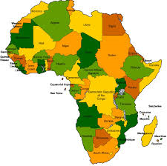
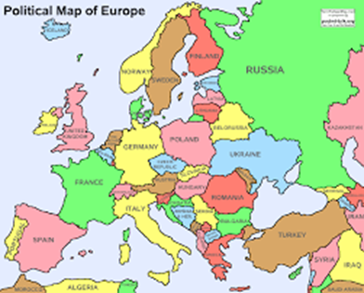
International Registration
Regional Registration Systems
CTM (Europe) 27* States
ARIPO (African Reg. Ind. Property Org.) 18 States
OAPI (African Intellectual Property Org.) 17 States
Apply directly Regional office
Need representative
Applicable fees
Must meet requirements for registration

Slide 10
UK direct filing

Slide 11
How does the system work?
Jamaica
USA
MARID System
UK
Japan
China

Slide 12
Madrid Protocol
International registration of Trade Marks
Avoid individual filing
Avoid agents in each country* (refusals)
Designate the countries for registration
Individual country fees & examination
Easier to manage (Changes, renewals, etc.)
Dependent on basic application or registration
94 Member States*
International Application submitted to WIPO through Member State IP Office*

Slide 13
Thank You
Herman Dawson
Telephone: (876).946.1300 / 946-0789
Fax: (876).927-6744
Website: http://www.jipo.gov.jm
Email: info@jipo.gov.jm

